Slide 1
Ancient Ethics

Slide 2
What is Ethics? Three Phases
ANCIENT: HOW SHOULD WE LIVE? -Ancient Philosophers, East and West -Both believe there is a Cosmic Order of Good
ENLIGHTENMENT: HOW SHOULD WE ACT? -Jeremy Bentham, Immanuel Kant -New Focus: Rationally determine “rules”
MODERN: HOW MIGHT WE LIVE? -Nietzsche, Existentialism -There is no right answer, only possibilities

Slide 3
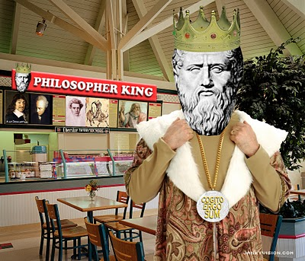
Plato’s Ethics
The GOOD, the BEAUTIFUL, and the TRUE, are Objective Ideals with real existence.
The True World over the False World:
The purpose of live is to strive for TRUTH, thus achieving GOODNESS in a BEAUTIFUL life. An EVIL person is WRONG. They live an UGLY life.
Since philosophers are closest to Truth, they must rule. “Until philosophers are kings cities will never have rest from their evils …”

Slide 4
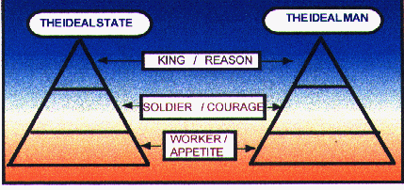
Plato’s Politics

Slide 5
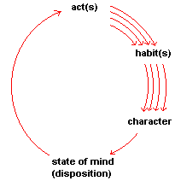
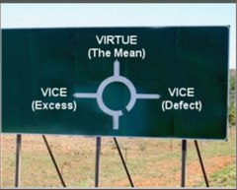
Aristotle’s Ethics
Eudaimonism: “Good Soul” – Pursuit of good living through excellence -What is a good person? Virtuous, effective and happy. -A “good person” is less like a saint and more like a well-functioning human specimen. “Excellence (arete) is not an act, but a habit.”
Teleology: “Final Cause” -What is the distinctive human quality? Reason. “All men by nature desire to know.” -Thus a well-functioning human specimen is one who is ruled by reason and acts accordingly. Phronesis – Practical Widsom.
Golden Mean: “Moderation” -There are no rules for being good except: Avoid extremes! - “A virtue is a midpoint between excess and deficiency” -Ex: Courage is better than cowardice OR recklessness.

Slide 6
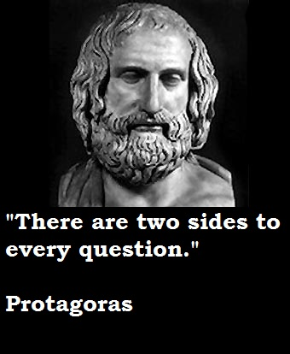
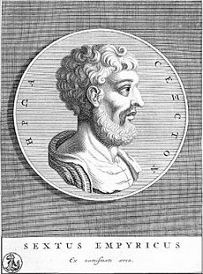
Relativism / Skepticism
Protagoras the Sophist: “Man is the Measure of All Things”
(Compare Shakespeare: “There’s nothing good or bad, but thinking makes it so.”)
So how should we live? Stress-free!
SEXTUS EMPIRICUS – soldier and traveler Cultural Relativism, Extreme Skepticism Purposely argues both sides of all debates Moral: Screw opinions. Live without belief.

Slide 7
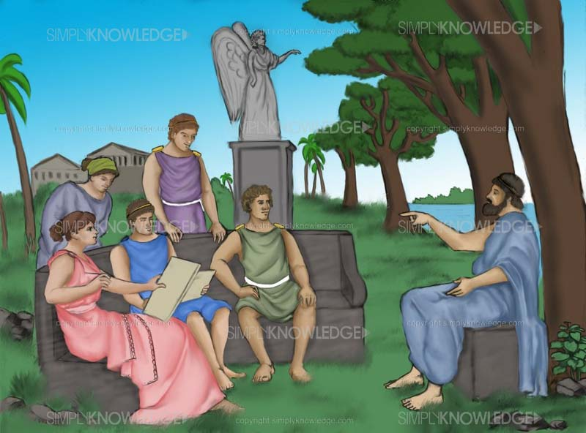
Epicurus
Hedonism: "I know not how to conceive the good, apart from the pleasures of taste, sexual pleasures, the pleasures of sound and the pleasures of beautiful form.”
Moderation: “It is better for you to be free of fear lying upon a pallet, than to have a golden couch and a rich table and be full of trouble. If thou wilt make a man happy, add not unto his riches but take away from his desires.”
Fearlessness: “Death does not concern us, because as long as we exist, death is not here. And when it does come, we no longer exist.”

Slide 8
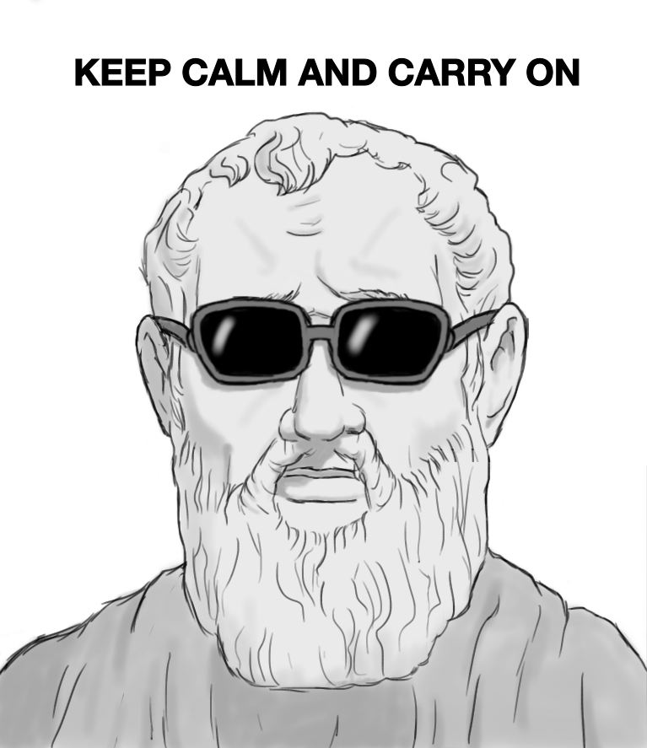
The Stoics

Slide 9
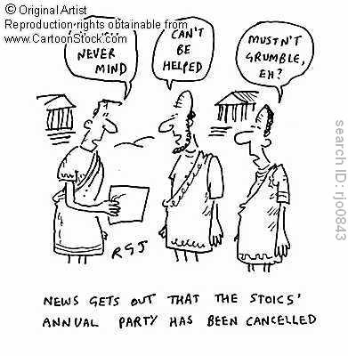
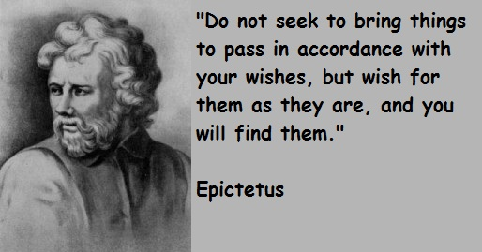
THE STOIC MOVEMENT

Slide 10
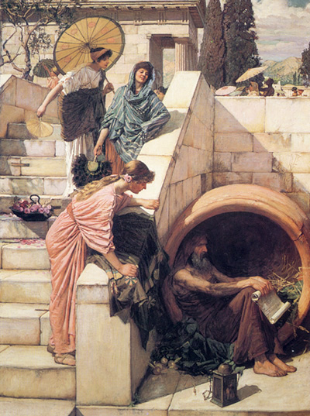
Diogenes and Cynicism
Kynikos = Dog
“Cynic” = Disillusioned
Diogenes the Cynic
“A Socrates gone mad”
A Pissed-off Thoreau
A philosophy focus on the pursuit of goodness through independent thought and behavior.

Slide 11
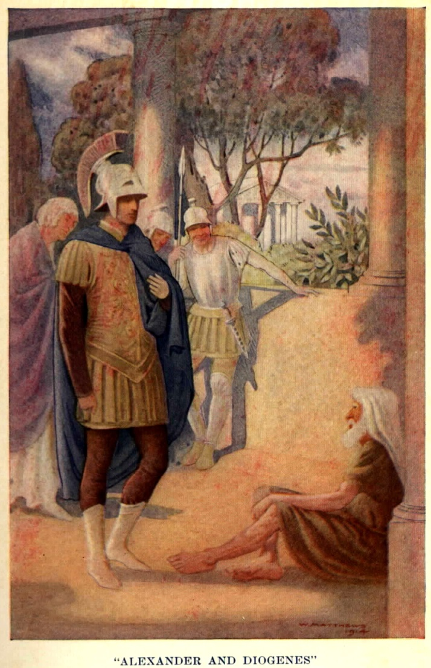
Tales of Diogenes
Seeing a child drinking from his hands, Diogenes threw away his cup and remarked, "A child has beaten me in plainness of living.“
When asked why he went about with a lamp in broad daylight, Diogenes confessed, "I am looking for a [honest] man.”
To Plato's definition of a man as an animal, bipedal and featherless, Diogenes plucked a chicken and declared, "Here is Plato's man."
To a young man who complained that he was ill suited to study philosophy, Diogenes said "Why then do you live, if you do not care to live well?"
Alexander the Great was reported to have said, "Had I not been Alexander, I should have liked to be Diogenes." Once, while Diogenes was sunning himself, Alexander came up to him and offered to grant him any request. "Stand out of my light," he replied

